Slide 1


Cab Catcher
Sreedhar
Alice
Maria Fernanda

Slide 2
About the Project
Analyze Taxi Trip Datasets from NYC Taxi and Limousine Commission
The New York City Taxi and Limousine Commission (TLC), created in 1971, is the agency responsible for licensing and regulating New York City's Medallion (Yellow) taxi cabs, for-hire vehicles (community-based liveries, black cars and luxury limousines), commuter vans, and paratransit vehicles

Slide 3
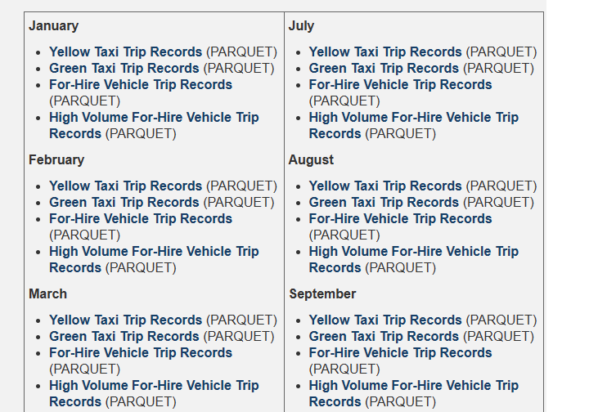
Datasets
Parquet format of data

Slide 4
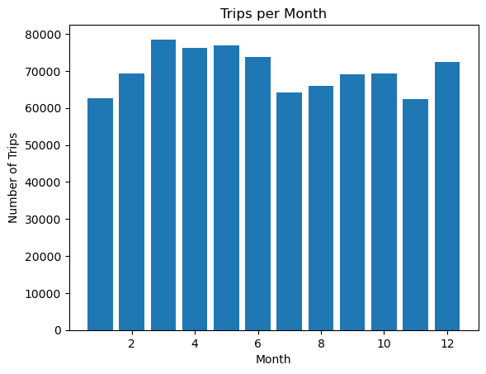
Trips per Month

Slide 5
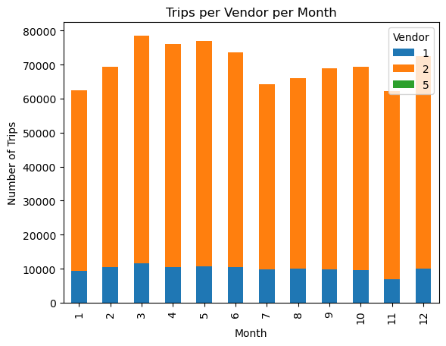
Trips per Vendor per Month

Slide 6
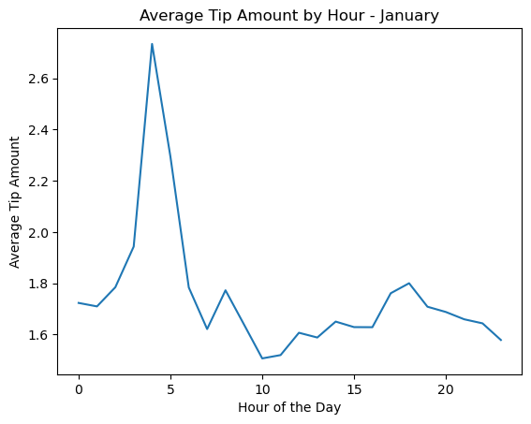
Average tip per Hour

Slide 7
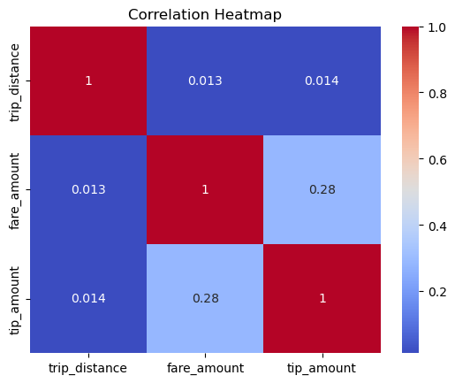
Correlation between the trip distance, the fare amount and the tip amount

Slide 8
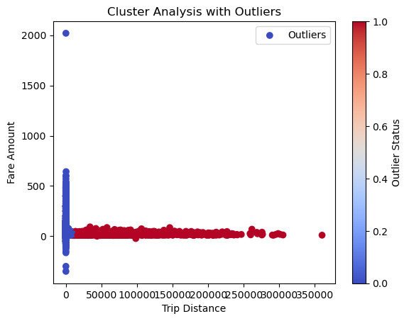
Cluster Analysis with Outliers

Slide 9
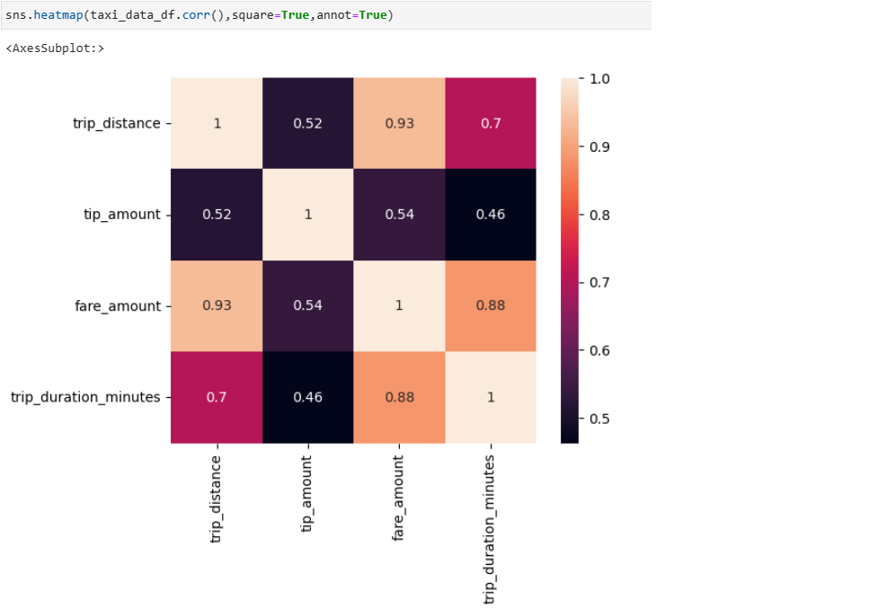
Taxi Trip Data Correlation

Slide 10
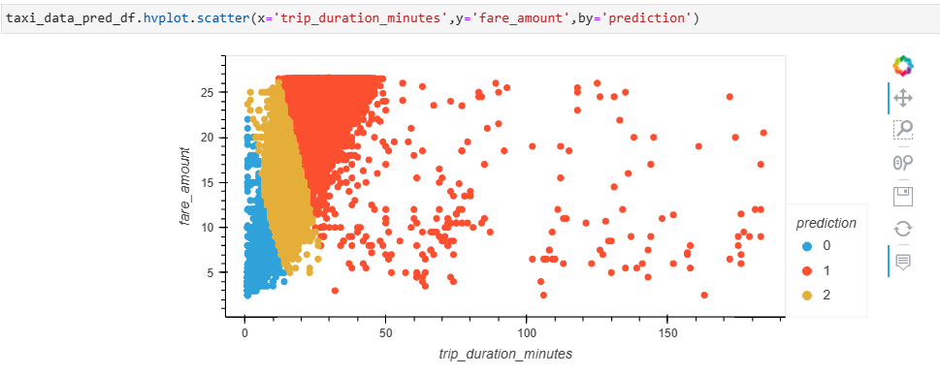
Kmeans Clusters (n_clusters = 3)

Slide 11
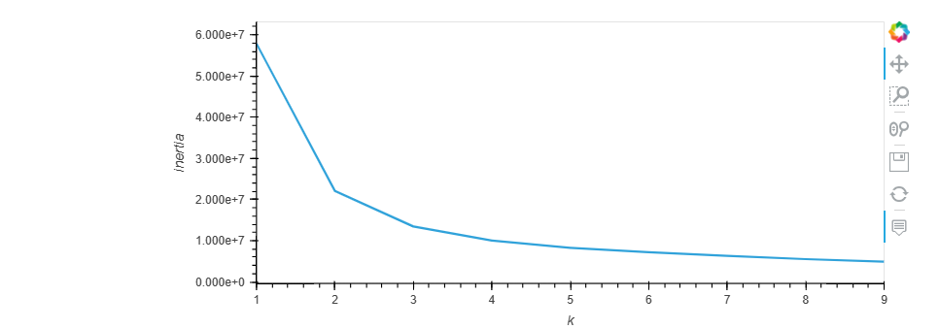
Kmeans Elbow Curve

Slide 12
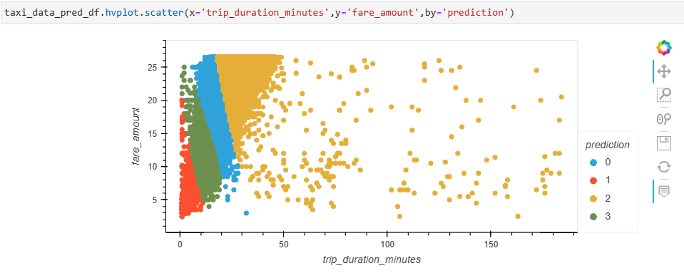
Kmeans Clutsers (n_clusters=4)

Slide 13
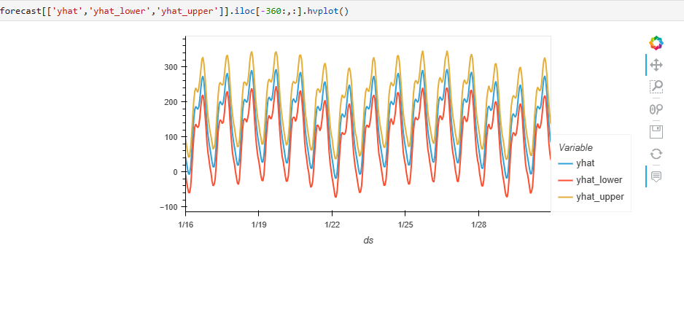
Prophet Model Forecasting

Slide 14
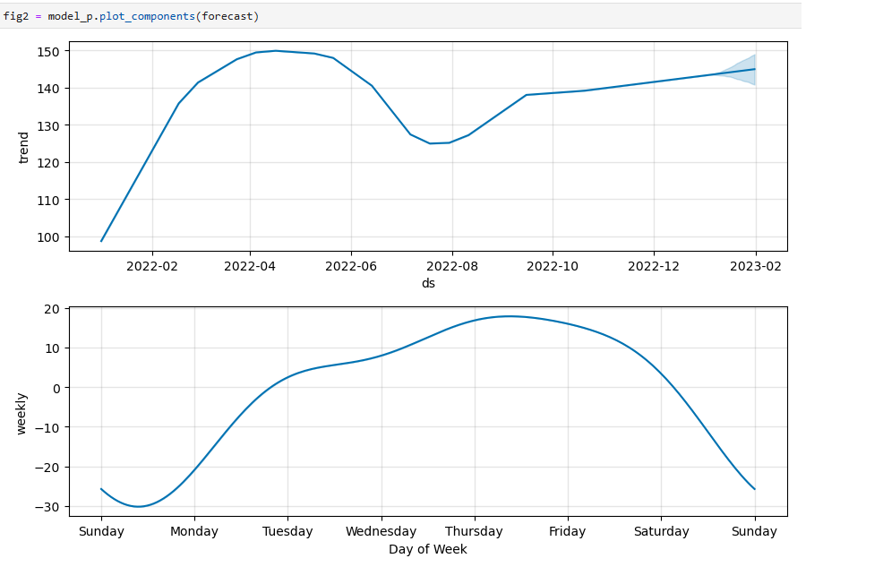
Plot Components

